Slide 1

DEPARTMENT OF COMPUTER SCIENCE AND ENGINEERING
Project name : Smart India Restroom Team name : Proj_224780_Team_2 Team members :
MOHITHA LAKSHMI N S (113321104062) MONIKA D (113321104063)
NAGALAKSHMI M (113321104064)
NAIDU K SUJITHA S KUMAR (113321104065)

Slide 2
INNOVATION:
An innovative idea for a smart public restroom could be a "Hygiene Hub." This restroom would feature:
1. Self-cleaning surfaces: Utilize UV-C or antimicrobial coatings to automatically sanitize high-touch surfaces like door handles, toilet seats, and faucets after each use.
2. Touchless technology: Incorporate motion-sensor faucets, soap dispensers, and flush mechanisms to minimize contact with surfaces.
3. Real-time occupancy monitoring: Display restroom availability on a mobile app, helping users find the nearest open facility.
4. Eco-friendly features: Implement water-saving toilets and sinks, energy-efficient lighting, and hand dryers, along with sustainable materials for construction.
5. Accessibility: Include features like braille signage, adjustable sinks and mirrors, and spacious, accessible stalls for individuals with disabilities.
6. Gender-neutral and family-friendly options: Design stalls that cater to diverse user needs, ensuring inclusivity.

Slide 3
7. Emergency assistance: Install an emergency button for immediate assistance in case of accidents or medical emergencies. 8. Maintenance alerts: Equip the restroom with sensors to notify cleaning staff when supplies are low or when cleaning is needed. 9. QR code feedback: Users can provide feedback by scanning a QR code, helping authorities address issues promptly. 10. Safety measures: Install security cameras and alarms to enhance user safety and deter vandalism. Such a Hygiene Hub would prioritize cleanliness, accessibility, and user experience, making public restrooms more efficient and pleasant for everyone.

Slide 4
IoT Sensor Design:
Creating a smart public restroom involves several objectives to enhance user experience, hygiene, and efficiency. Here are some key objectives:
Improved Hygiene: Ensure cleanliness through automated cleaning and sanitization processes, touchless fixtures (faucets, soap dispensers, flush buttons), and UV-C or other disinfection technologies.
2. Water Conservation: Reduce water wastage by using sensor-based faucets and toilets that optimize water usage.
3. Energy Efficiency: Implement energy-efficient lighting and HVAC systems, utilizing motion sensors to reduce electricity when the restroom is unoccupied.
4. Accessibility: Make the restroom accessible to all, including people with disabilities, by following accessibility standards and installing features like grab bars and wider stalls.
5. Real-time Monitoring: Install sensors to monitor restroom conditions, such as occupancy, cleanliness, and supply levels, and enable maintenance staff to respond promptly.
6. Smart Maintenance: Implement predictive maintenance systems that anticipate and address issues before they become major problems, reducing downtime.

Slide 5
7. User Experience: Enhance the overall experience with features like touchless payment for access, occupancy indicators, and pleasant aesthetics. 8. Sustainability: Incorporate sustainable materials, reduce waste through smart waste management, and consider renewable energy sources for power. 9. Security: Ensure the safety of users through surveillance cameras and emergency call buttons. 10. Data Analytics: Collect data on restroom usage patterns to optimize cleaning schedules, supply restocking, and resource allocation. 11. Universal Design: Prioritize a design that caters to people of all ages, genders, and backgrounds. These objectives aim to create a safe, efficient, and pleasant restroom experience for the public while incorporating technology and sustainability to meet modern needs.

Slide 6
IoT Sensor Setup:
Setting up IoT sensors in a smart public restroom involves strategically placing sensors to monitor various aspects of the restroom's operation and usage. Here's a basic overview of the types of sensors you might use and their purposes: 1. Occupancy Sensors: These can be motion or infrared sensors placed near the entrance and inside the restroom to detect when someone enters or leaves. This information can help in managing cleaning schedules and resource allocation. 2. Water Sensors: Install sensors near faucets and toilets to monitor water flow. This can help in detecting leaks, water wastage, and optimizing water usage. 3. Toilet Flush Sensors: These sensors detect when a toilet is flushed, which can be useful for monitoring usage and optimizing cleaning schedules. 4. Soap and Paper Dispenser Sensors: Place sensors on soap dispensers and paper towel or hand dryer dispensers to monitor usage and ensure that they are refilled promptly. 5. Air Quality Sensors: Measure air quality for temperature, humidity, and potentially harmful gases. This helps maintain a comfortable and healthy restroom environment. 6. Light Sensors: Use light sensors to adjust restroom lighting based on natural light and occupancy, optimizing energy usage.

Slide 7
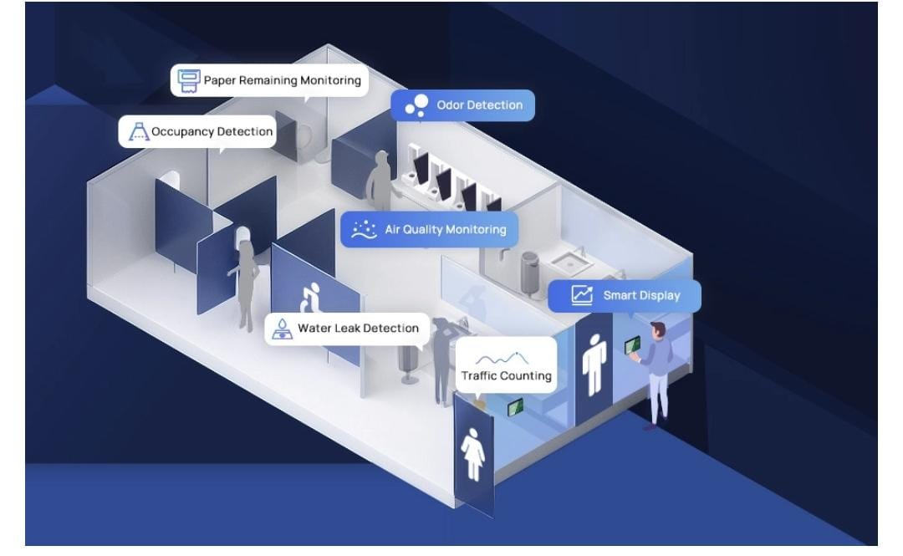

Slide 8
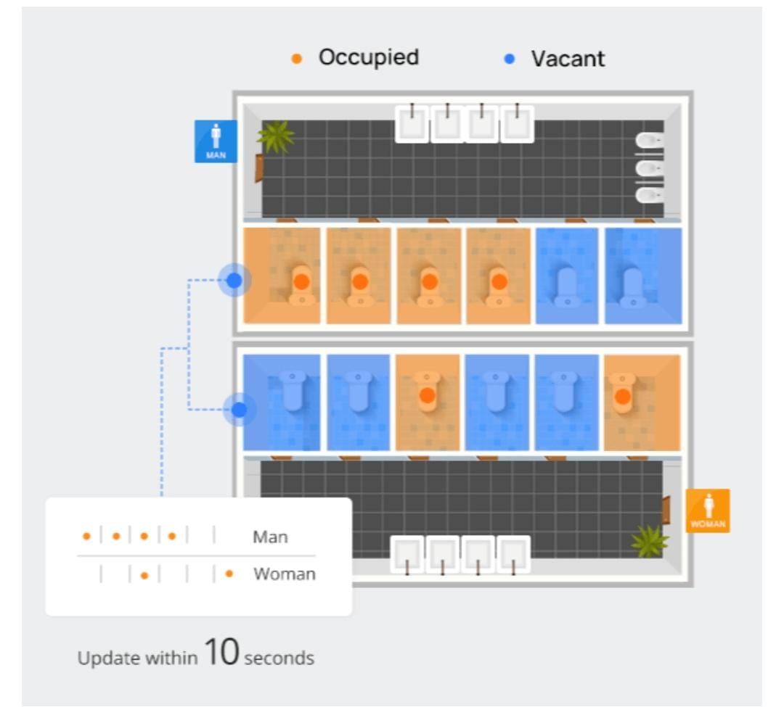

Slide 9
Raspberry pi integration:
Integrating Raspberry Pi into a smart public restroom can add significant functionality and control to various aspects of restroom management. Here are detailed steps on how to do this:
1. Raspberry Pi Selection: - Choose an appropriate Raspberry Pi model based on your requirements, considering factors like processing power, connectivity options, and power consumption.
2. Sensor Integration: - Connect various sensors to the Raspberry Pi via GPIO pins, USB ports, or other suitable interfaces. Ensure you have the necessary libraries and drivers for these sensors. - Write code to collect data from sensors. For example, read occupancy data from motion sensors, water flow data from flow sensors, or temperature and humidity data from environmental sensors.
3. Data Processing: - Use Python or another suitable programming language to process the data collected from sensors. - Implement algorithms to analyze the data, such as determining restroom occupancy patterns or identifying anomalies like water leaks.
4. User Interface: - Create a user-friendly interface for restroom users and administrators. This can be a touchscreen display, web-based dashboard, or a mobile app. - Design the interface to display real-time information, such as restroom occupancy status, cleaning schedules, or alerts.
5. Connectivity: - Ensure the Raspberry Pi is connected to the internet, either through Wi-Fi or Ethernet, to enable remote monitoring and control. - Implement secure protocols and encryption to protect data transmission.
6. Remote Monitoring: - Set up remote monitoring capabilities to allow administrators to check restroom status and receive notifications about issues or maintenance needs.

Slide 10
7. Automation and Control: - Program the Raspberry Pi to automate various functions, such as controlling water faucets, flush systems, or hand dryers based on occupancy or sensor data. - Implement scheduling algorithms for cleaning and maintenance tasks. 8. Security: - Secure the Raspberry Pi and the entire system to prevent unauthorized access or tampering. Use strong passwords, firewall rules, and regular software updates. 9. Power Management: - Ensure a stable power supply for the Raspberry Pi to avoid unexpected shutdowns. Consider backup power solutions like UPS devices. 10. Cloud Integration: - Connect the Raspberry Pi to cloud services (e.g., AWS, Azure, Google Cloud) for data storage, analytics, and remote management. This enables scalability and data analysis. 11. Alerts and Notifications: - Set up alerts and notifications for critical events, such as restroom over-occupancy, water leaks, or low supply levels. These alerts can be sent via email, SMS, or push notifications. Integrating Raspberry Pi into a smart public restroom requires a combination of hardware and software skills. Collaboration with experts in IoT, sensors, and software development may be necessary to ensure a successful implementation.

Slide 11
Creating a complete code implementation for a smart public restroom involves a wide range of sensors and functionalities. Here, I’ll provide you with a high-level overview and a simplified Python example for occupancy monitoring using a Raspberry Pi and a PIR motion sensor. This is just one aspect of a smart restroom system: Step 1: Hardware Setup 1. Connect a PIR motion sensor to your Raspberry Pi GPIO pins (e.g., GPIO17). Step 2: Python Code Implementation Install the necessary libraries: ```bash pip install Rpi.GPIO``` Now, create a Python script for occupancy monitoring: import RPi.GPIO as GPIO import time
Code implementation :

Slide 12
# Define GPIO pin for the motion sensor motion_sensor_pin = 17 # Initialize GPIO GPIO.setmode(GPIO.BCM) GPIO.setup(motion_sensor_pin, GPIO.IN) try: while True: # Read motion sensor data motion_detected = GPIO.input(motion_sensor_pin) # Determine restroom occupancy if motion_detected: print(“Restroom is occupied”) else: print(“Restroom is vacant”) time.sleep(1) # Check the sensor every second except KeyboardInterrupt: print(“Exiting…”) finally: GPIO.cleanup()

Slide 13
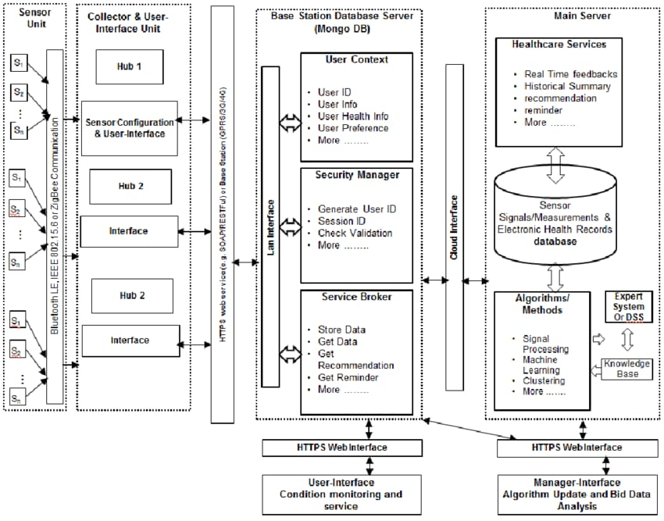
Raspberry PI Integration

Slide 14
Conclusion:
In conclusion, the innovative advancements in smart public restrooms have the potential to significantly enhance user experiences and improve overall hygiene and efficiency. These innovations, ranging from touchless fixtures and sensors to real-time monitoring and maintenance, not only cater to the needs of the public but also contribute to a more sustainable and connected urban environment. As cities continue to grow and evolve, investing in smart public restrooms is a forward-thinking step toward creating cleaner, safer, and more convenient facilities for all.

Slide 15
THANK YOU!

